Slide 1


Final Project Presentation
On
AI For Skin Disease Detection
Presented By
AMISHA BASNET (28903/078)
SAISA KOIRALA (28932/078)
SANDESH KHATIWADA (28936/078)
Supervised By
Mr. Pawan Niroula

Slide 2
Presentation Outline
Introduction
Objectives
System Analysis
System Design
Implementation and Testing
Final Outcome

Slide 3
Introduction
Skin diseases are common global health concerns
Early diagnosis is essential for proper treatment
Manual methods are slow and less accessible
AI enables fast, accurate medical image analysis
Our system detects 9 types of skin diseases
Flask powers backend with AI model integration
HTML, CSS, JS build interactive web interface

Slide 4
Objectives
Accessible through any modern web browser
Users log in with secure authentication system
Upload skin images for disease classification
Flask backend processes input with AI model
HTML, CSS, JS create interactive user interface
Database stores user data and prediction history
Provides real-time, accurate, and fast results

Slide 5
SYSTEM ANALYSIS
Functional Requirements :
User login and authentication
Uploading skin images
Disease classification using AI model
Displaying probability scores
Visualization of prediction results
Saving past records
Providing external references

Slide 6
SYSTEM ANALYSIS
Non Functional Requirements :
Secure encrypted login
Simple, user-friendly interface
Modular, maintainable codebase
Reliable and accurate outputs
Scalable for future growth
Portable across platforms
Consistent performance

Slide 7
SYSTEM ANALYSIS
Technical Feasibility
Frontend: HTML, CSS, and JavaScript
Backend: Flask with AI model integration
AI Models: CNN, MobileNet, DenseNet121
Developed using Python, TensorFlow/Keras

Slide 8
SYSTEM ANALYSIS
Operational Feasibility
Users upload images via web interface
Provides automated disease predictions
Accessible for patients and medical staff

Slide 9
SYSTEM ANALYSIS
Schedule Feasibility
Project duration: 40–50 days
Tasks: dataset, model, integration, deployment
Progress tracked via WBS and Gantt Chart

Slide 10
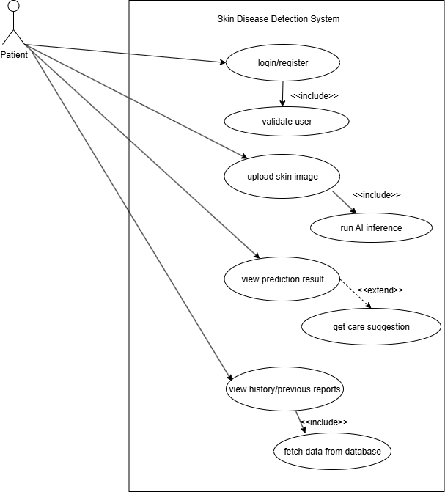
SYSTEM ANALYSIS
Fig. use case diagram of Skin disease detection using AI
fig. use case diagram

Slide 11
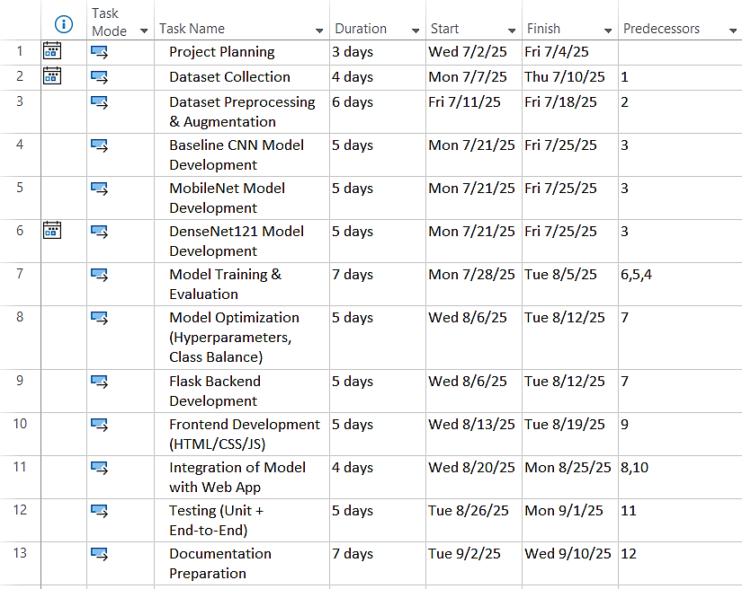
SYSTEM ANALYSIS
Fig. Work Breakdown Structure

Slide 12
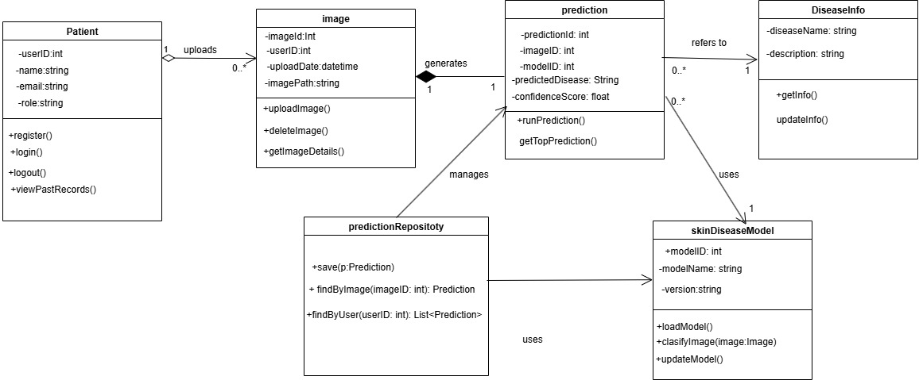
SYSTEM DESIGN
Fig. Class diagram

Slide 13
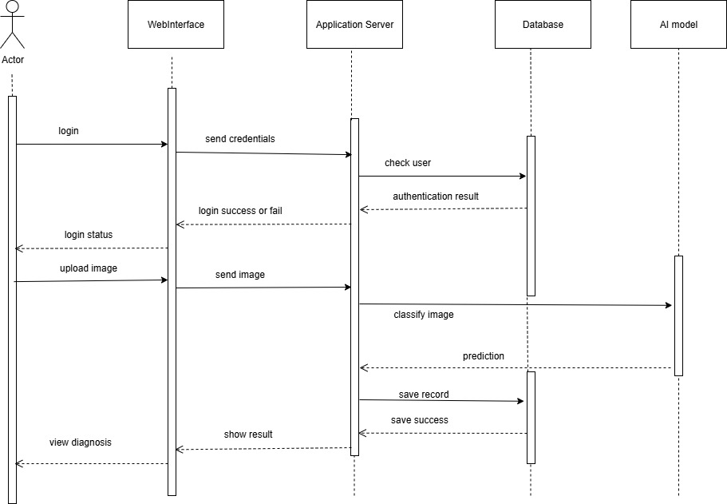
SYSTEM DESIGN
Fig: Sequence diagram of Skin disease detection using AI

Slide 14
login process
Actor starts login request
Web Interface sends credentials
Server checks credentials with Database
Database returns authentication result
Server informs Web Interface of status
Web Interface shows login result
Actor sees success or failure

Slide 15
Image upload and diagnosis
Actor uploads image after login
Web Interface forwards image to Server
Server sends image to AI Model
AI Model classifies image and returns result
Server saves result in Database
Database confirms record successfully saved
Actor views final diagnosis result

Slide 16
Algorithm Details
Uses CNN, MobileNet, DenseNet pretrained models
Applies image preprocessing: resize and normalize
Extracts features using convolutional layers
Uses Global Average Pooling and dropout layers
Final classification with softmax activation
Trains on labeled skin disease images
Validates accuracy with held-out test set

Slide 17
Algorithm Details
Dataset images resized to 240x240 pixels
Images normalized to improve training stability
Models fine-tuned on medical skin datasets
Uses categorical cross-entropy loss function
Optimized with Adam optimizer for faster learning
Implements dropout to reduce overfitting
Produces probability scores for each skin class

Slide 18
Algorithm Details
Deployment through Flask web interface
Users upload images for instant prediction
System returns predicted disease with confidence
Enables easy access in clinical and remote areas
Designed for real-time skin disease detection
Supports early diagnosis and treatment decision
Helps dermatologists by automating image analysis

Slide 19
Data Preprocessing
Data Cleaning
Resize images to 224×224 pixels
Normalize pixels (scale 1/255)
Augment: rotate, move, zoom, flip
Increase data variability
Reduce overfitting
Improve generalization

Slide 20
Data Pre-Processing
Label Encoding
Convert folder names to labels
Assign integer to each class
Use flow_from_directory for encoding
Map images to numerical labels

Slide 21
Data Pre-Processing
Exploratory Data Analysis
Check images per class
Identify dataset imbalance
Apply class weights during training
Visualize class distribution
Prepare data for training

Slide 22
Data Pre-Processing
Feature Extraction
Use DenseNet121 pretrained on ImageNet
Extract edges, textures, patterns
Feed features to dense layers
Avoid manual feature engineering

Slide 23
Implementation and Testing
Unit Testing
Tested components in isolation
User login, registration, image upload
Model prediction & admin functions
Verified with expected vs actual results

Slide 24
Implementation and Testing
Integration Testing
Checked interaction of frontend, backend, database
Verified image upload, preprocessing, prediction
Ensured smooth workflow across modules

Slide 25
Implementation and Testing
System Testing
Evaluated complete system functionality
Tested accuracy, performance, batch uploads
Ensured requirements were fully met

Slide 26
Implementation and Testing
Model Testing
Validated DenseNet121 & MobileNet models
Accuracy on test dataset (82%)
Checked confusion matrix for class balance

Slide 27
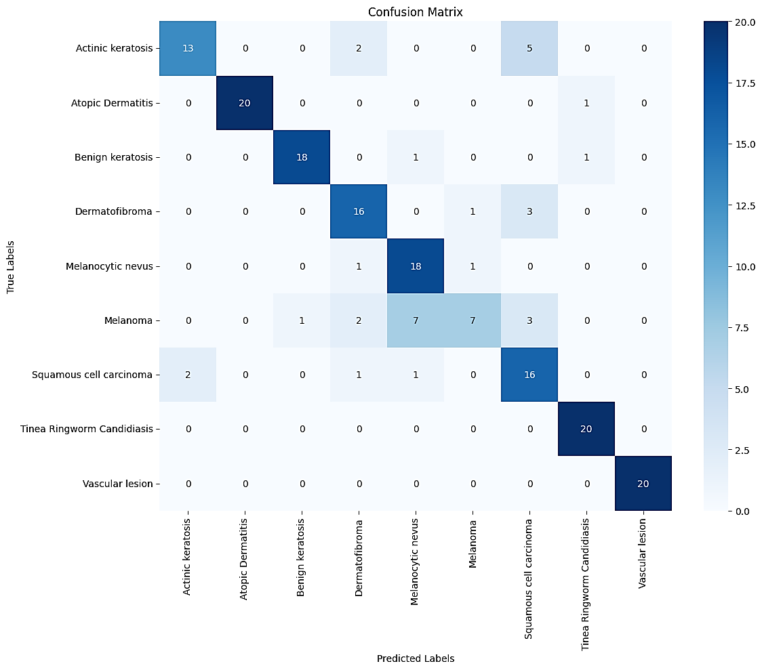
Confusion Matrix

Slide 28
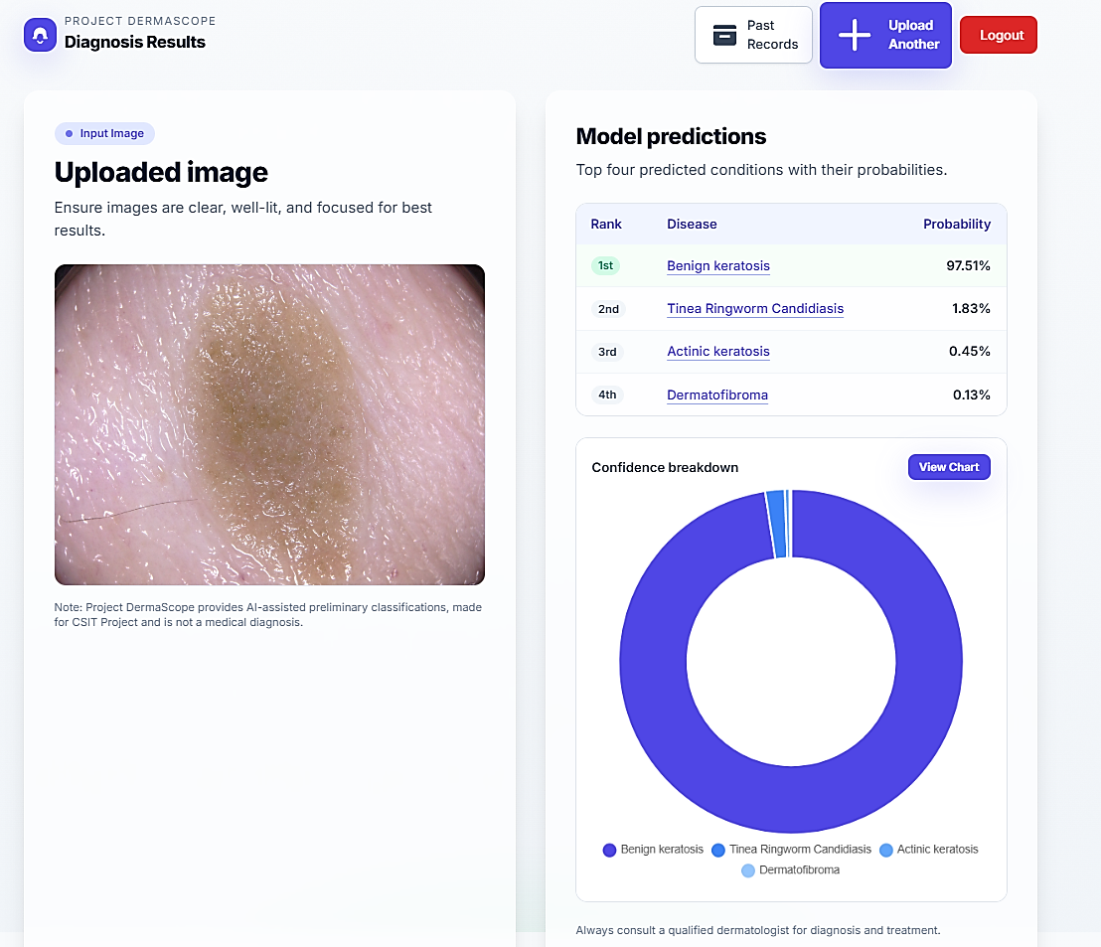
Final Outcomes

Slide 29
Thank you

